Slide 1





Creating Trauma Sensitive AZ Schools-Bootcamp Series

Slide 2
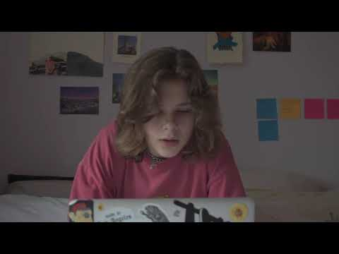
Notes:
While there may be some students that may enjoy being at home and working virtually, I would venture to say that most kids would far prefer being back at school. Even for those in the best circumstances at home, they still miss their friends and the interactions they have with their teachers. There is also the sheer monotony of the online virtual education world, the same thing every day, in the same location, in front of the same screen. And what about the the students or are in a home where there isnt enough food or being exposed to violence or abuse. For so many, school is the only safe place they have. This video highlights why relationships are so important. We build relationships not just so students can learn better – but so they can live better.

Slide 3
Relationships are the Key to Resilience
Now more than ever, it is important for teachers to promote positive, healthy relationships with their students by noticing and being sensitive to what they need, being attuned to those needs, and responding to students in warm, inclusive, and supportive ways.
e.
Notes:
We need to prioritize student relationships
Given the research emerging on essential role of early caregiver-child relationships on lifelong health, Chair of the American Academy of Pediatrics (AAP) Early Brain and Child Development Initiative David Willis proposed a “4th Vital Sign” (after respiration, heart rate, and blood pressure) . Adding this fourth vital sign places the spotlight on relationships in pediatric assessments.

Slide 4
Students with a high sense of belonging are
happier, healthier, and more engaged learners, less likely to skip school, abuse substances, have emotional distress, or be involved in fighting or bullying behavior.

Slide 5
Creating a Safe Environment
It is very important to maintain predictable and consistent routines. Consistency and predictability help students maintain a sense of psychological safety and a sense that they can manage stress or connect with someone who can support them during times of adversity.
In addition, it is equally as important to provide opportunities for students to engage in social emotional learning practices and wellness activities that promote a sense of self-worth and safety.

Slide 6
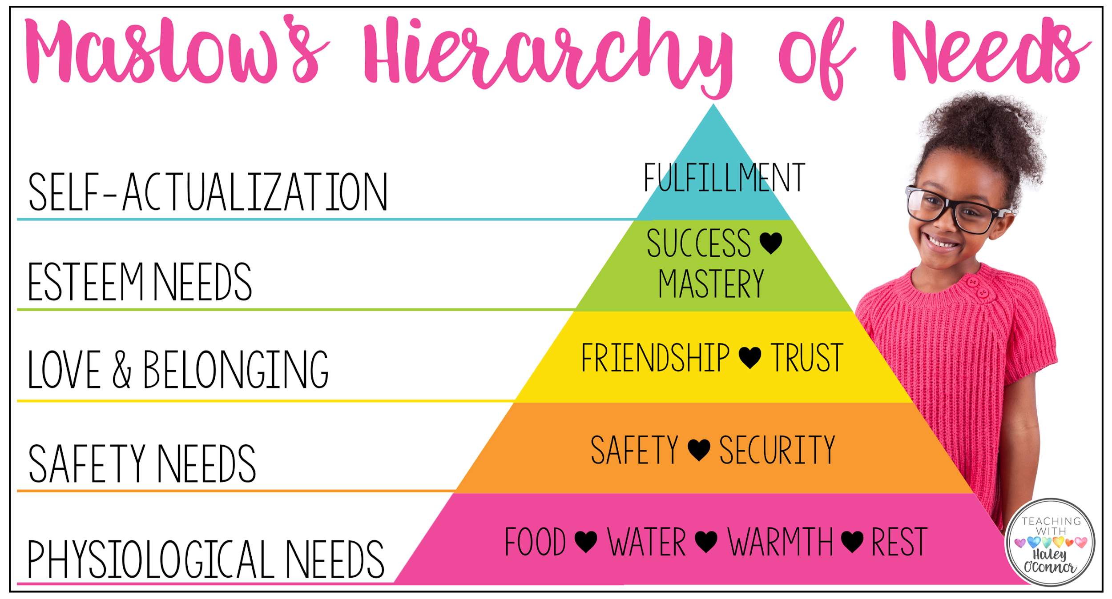
Notes:
We all are familiar with Maslow’s Hierarchy of needs, which essentially states that kids can’t learn higher orders of thinking until their more fundamental needs are met. Although it’s harder to gauge these things when students are online there are things that can be done in the classroom or remotely that can help.

Slide 7
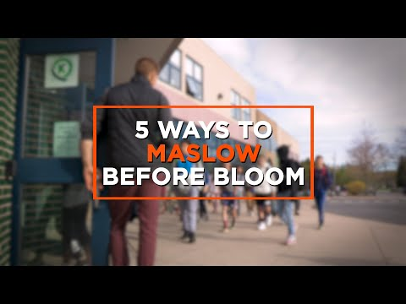

Slide 8
Greeting at the Door
Low Cost- High Yield
Proactive Management Strategy

Slide 9
Neuroscience Says...
Autonomic Nervous System reacts to experiences and regulates responses
The Social Engagement System- Face-Heart Connection
These pathways send and search for signals of welcome and signals or warning.
Polyvagal Theory- Stephen Porges

Slide 10
Educators Say...
Sets a positive tone
Promotes well-being
Social/Emotional skills for life
Builds community
Builds trust
Allows for early intervention/proactiveGreetinto the environment are also considered proactive and protective factors for students. Proactive; we can get an o
203 students, 10 Classrooms= 20% increase in academics/ 9% decrease in disruptive behaviors

Slide 11
Greeting at the door
Say the students name
Make eye contact
Use a friendly nonverbal greeting - examples 1) in person we touch elbows, 2) virtually we wink
Give a few words of encouragement, use proactive statements, show interest
Notes:
Try to make sure your kids know you are thinking of them, care for them, and miss them.
Greeting into the environment are also considered proactive and protective factors for students. Proactive; we can get an overall “sense” of the current state of mind of the child. Protective, we can then be very purposeful in offering timely interventions.
Say the students name
Make eye contact
Use a friendly nonverbal greeting - examples 1) in person we touch elbows, 2) virtually we wink
Give a few words of encouragement, use proactive statements, show interest

Slide 12
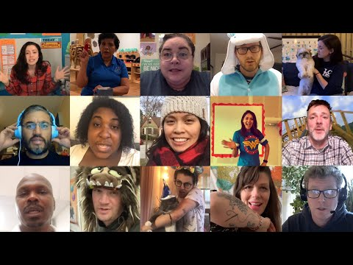
Notes:
Try to make sure your kids know you are thinking of them, care for them, and miss them. Simple daily hellos via video might be the only time the student sees the teacher on some days—and that sense of connection is important to sustain.

Slide 13
You look with your eyes, but seeing is something you do with your heart.
Don’t make people feel invisible. Love them. Honor them. Acknowledge them.

Slide 14
Our students need connection,
they need you!
Notes:
We need to prioritize student relationships

Slide 15
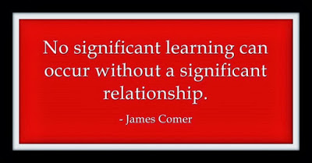
Thank you!
Notes:
We had the honor to share this information with you. Be Safe, Be well and Thank you

Slide 16
Resources
https://www.weareteachers.com/building-relationships-remote-learning/
https://www.albert.io/blog/building-relationships-teaching-remotely/
https://teacheveryday.com/build-relationships-distance-learning/
https://www.edutopia.org/article/7-ways-maintain-relationships-during-your-school-closure
https://www.edutopia.org/article/3-ways-build-relationships-person-or-virtually
https://www.panoramaed.com/blog/8-strategies-sense-of-belonging-virtually
https://www.edweek.org/technology/nurturing-teacher-student-connections-in-a-virtual-world/2020/07
https://edsource.org/2020/on-or-off-california-schools-weigh-webcam-concerns-during-distance-learning/638984

